Slide 1
Personalized Diet Recommendation
A Web Application Utilizing Flask Backend and Pretrained Machine Learning Algorithm
By-
SAI VEEHARIKA
121322030016

Slide 2
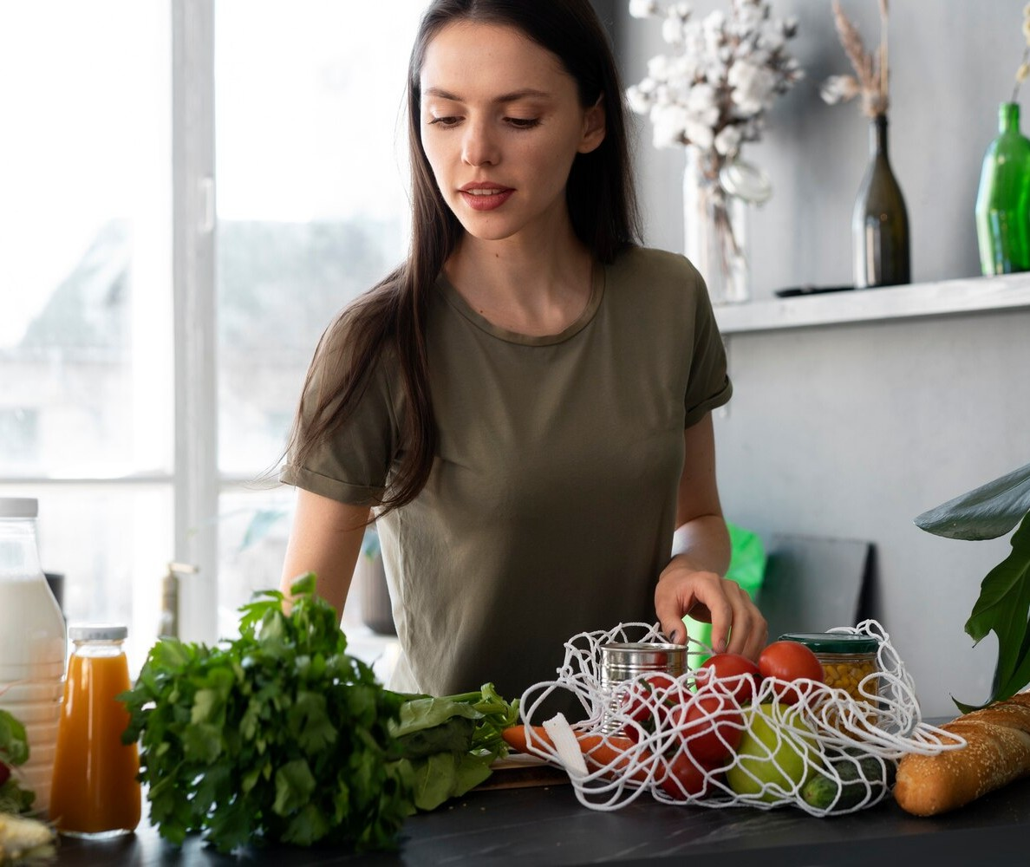
INTRODUCTION
This presentation explores the impact of personalized diet recommendations on health and wellness.
We will discuss the utilization of a Flask backend and pretrained machine learning algorithm to develop a web application. The goal is to empower individuals to make informed dietary choices for improved wellness .

Slide 3
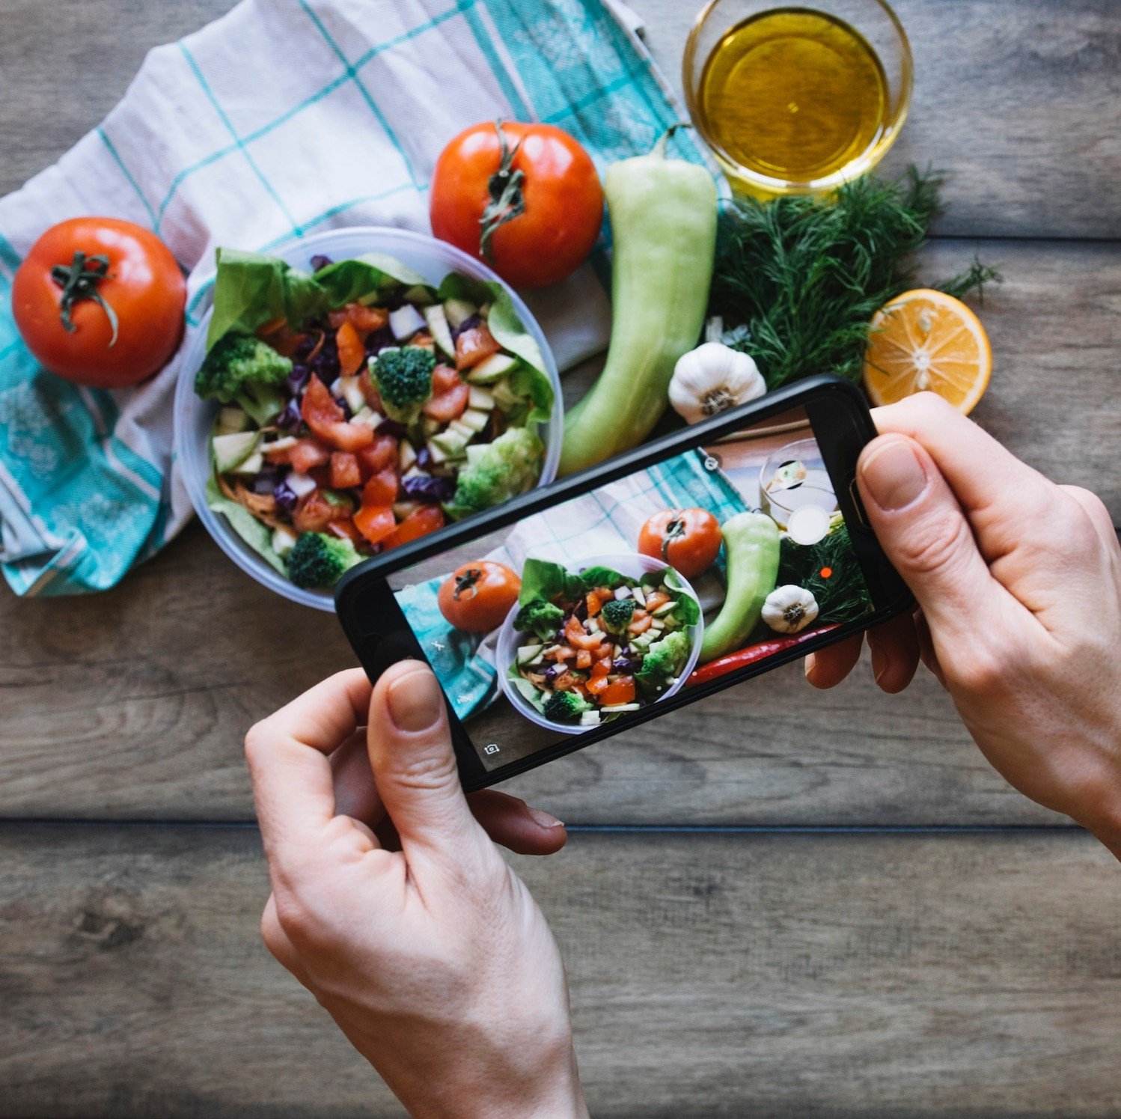
OBJECTIVE
At this web Application, our mission is to provide you with a seamless and intuitive platform that leverages the power of artificial intelligence and machine learning.
We want to assist you in identifying potential health concerns based on your reported symptoms to characterize associated diseases, providing tailored diet and workout plans along with necessary precautions and medication guidance for optimal health management.

Slide 4
Scope and Applicability
Scope:
Personalized Health Management
Disease Characterization and Management
Nutritional Guidance and Education
Fitness and Wellness Optimization
Applicability:
Individuals Seeking Personalized Health Solutions
Chronic Disease Management Programs
Research and Data Analysis in Health Sciences
Global Accessibility and Scalability

Slide 5
REQUIREMENTS
Data Collection and Input Handling
Symptom Characterization and Disease Identification
Diets Database Workout Precautions and Medication Integration Recommendation Engine
Machine Learning Models and Algorithms
Our platform utilizes a robust machine learning-Support Vector Machine Classifier model trained on a vast dataset of symptoms and diseases which integrates with appropriate Diets Recommendations
By inputting your symptoms, our system generates accurate predictions about potential illnesses, allowing you to make informed decisions about your health.

Slide 6
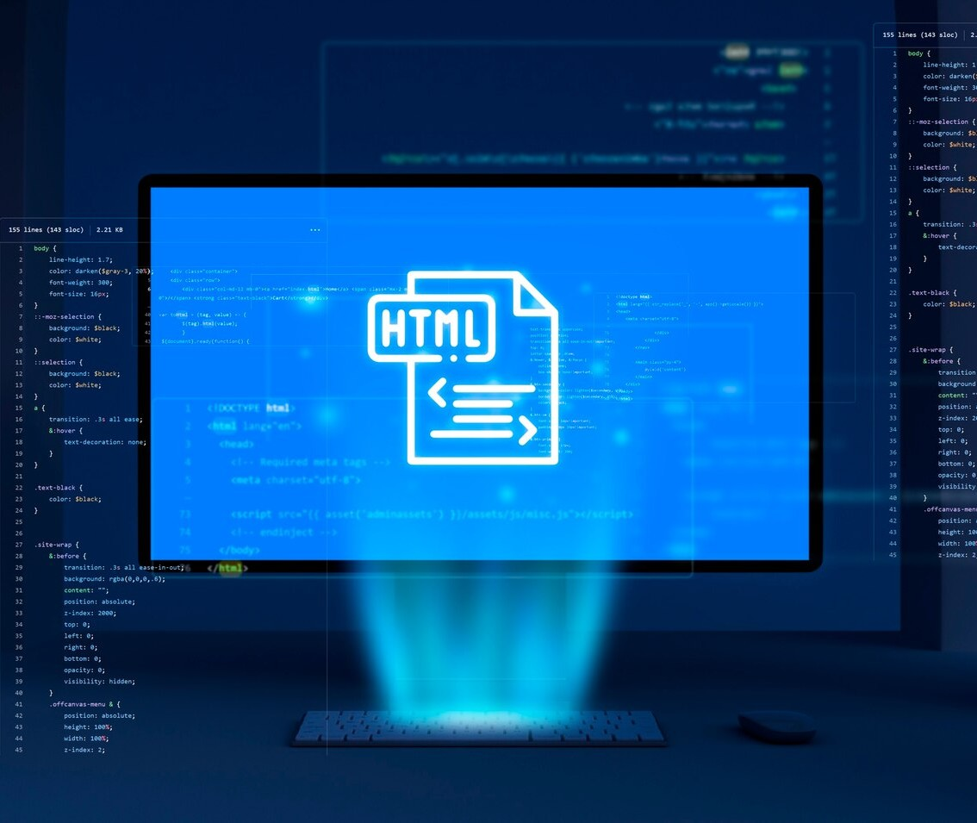
FLASK BACKEND
Flask offers a robust and ﬂexible framework for building web applications. Its simplicity and extensibility make it an ideal choice for developing the backend of our personalized diet recommendation platform With Flask, we can ensure eﬃcient data processing and seamless user interaction.

Slide 7
PROBLEM STATEMENT
The project began with recognizing a common issue: people often experience symptoms and want quick answers about their health concerns. It can be challenging to differentiate between various diseases, especially when symptoms overlap. Our goal was to provide a convenient solution for users to input their symptoms and receive potential diagnoses.

Slide 8
IMPLEMENTATION RESULTS
WEB APPLICATION
We developed a web application that allows users to enter a list of symptoms they are experiencing. The application then uses a pre-trained Support-Vector Classifier model to predict the most likely disease based on the provided symptoms. Here's how it works:
Symptom Input: Users enter their symptoms through a user-friendly interface. The web app supports a wide range of symptoms, making it versatile for different scenarios.
Machine Learning Model: We trained a Support Vector Classifier using a dataset containing symptoms and corresponding diseases. The model is capable of predicting diseases based on input symptoms.
Prediction: The application uses the model to predict the most likely disease, providing users with appropriate Diet Recommendation and Workout Tips and also provides additional information about the predicted disease. This includes a description of the disease, recommended precautions and medications

Slide 9
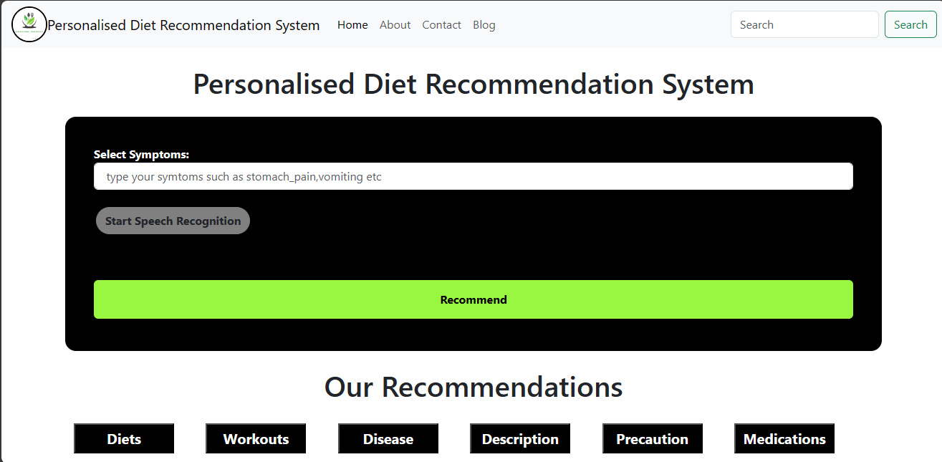
WEB APPLICATION

Slide 10
WEB APPLICATION
Key Features
User-Friendly Interface: This web app boasts an intuitive and easy-to-navigate interface, ensuring that users can input their symptoms without any hassle.
Accurate Predictions: Leveraging machine learning, our model provides accurate disease predictions based on the symptoms provided by the user.
Comprehensive Information: In addition to predictions, the app offers comprehensive information about the predicted disease, including descriptions, precautions, medications, diet recommendations, and workout tips.

Slide 11

CODING DETAILS
Link-
Diet_Recommendation_system - Jupyter Notebook
Link for web application-
Personalised Diet Recommendation System

Slide 12
CONCLUSION
Our Personalized Diet Recommendation System brings the power of machine learning and healthcare information to the fingertips of users. It serves as a valuable resource for individuals looking to gain insights into their health conditions quickly and conveniently. By combining technology and healthcare, we aim to make healthcare more accessible and user-centric.
In an era where remote healthcare solutions are gaining prominence, this project represents a significant step forward in providing accessible and reliable healthcare information to the masses. We hope that this Personalized Diet Recommendation System will contribute to better health awareness and ultimately improve the well-being of individuals worldwide.

Slide 13
FUTURE DEVELOPMENTS
In addition to diet and workout recommendations, future systems will incorporate holistic wellness strategies, including stress management techniques, sleep optimization strategies, and mental health support. By considering the interconnectedness of physical, mental, and emotional well-being, these systems will provide more holistic and effective solutions for overall health improvement.

Slide 14
THANK YOU

